Slide 1
AML-3303: Software Tools and Emerging Technologies for AI & ML

Slide 2

Welcome to class!
What is this class about?
What will we be studying and learning about here?
What skills will you acquire?
Why should you be interested in this class?

Slide 3
What is this class about?
This class is about software tools and emerging technologies that power AI and ML development.
Not just models and algorithms → but the ecosystem of tools that make AI usable in the real world.
We’ll explore collaboration tools, version control, project tracking, CI/CD pipelines, cloud deployment, big data systems, and AI/ML toolkits.

Slide 4
Software engineering foundations for AI/ML projects (Agile, Scrum, SDLC, scalable architectures)
Collaboration and source control tools like Git, GitHub, GitLab, Jira, Slack, Microsoft Teams, Notion
Generative AI (Large Language Models, prompt engineering, RAG, vector databases, Claude/OpenAI/Gemini APIs, Hugging Face)
CI/CD and MLOps tools like Docker, GitHub Actions, AWS SageMaker, MLflow
Big Data, Databases and AI/ML toolkits (NoSQL, MongoDB, PostgreSQL, Spark, Pandas, PostgreSQL, Spark, PyTorch, TensorFlow, Scikit-learn)
Agentic AI (AI agents, tool use, Model Context Protocol (MCP), LangGraph, and AI coding assistants like Claude Code, GitHub Copilot, Cursor)
What will we be studying and learning about here?

Slide 5
What skills will you acquire?
By the end of this course, you’ll be able to:
Work effectively in AI/ML teams using collaboration and version control practices.
Manage, version, and deploy code and models using modern cloud and container environments.
Build Generative AI applications using LLM APIs, prompt engineering, and retrieval-augmented generation (RAG).
Handle large and complex datasets efficiently.
Apply AI/ML techniques to solve practical problems, including text, images, and data analysis.
Design and supervise AI agents that plan, use tools, and connect to data through MCP.
Connect your AI/ML skills with real-world workflows, preparing you for industry or research projects.

Slide 6
Internship readiness: These are the exact skills companies ask for when they hire AI interns.
Bridge to industry: You’ll learn how to go from “I trained a model” → to “I deployed a working ML system.”
Cutting-edge relevance: We’ll touch on LLMs, cloud AI services, and emerging MLOps practices.
High demand skills: Knowing these tools makes you stand out, because many grads only know theory/models, not how to integrate them into products.
Why should you be interested in this class?

Slide 7
Required Materials
Software Engineering: A Practitioner's Approach (9th Edition)
  Author: Roger S. Pressman, Bruce R. Maxim
  ISBN-13: 978-1259872976
  Publisher: McGraw-Hill Education
  Published: 2020
Software Test Procedures and Methodologies
Machine Learning & AI
Hands-On Machine Learning with Scikit-Learn, Keras, and TensorFlow (3rd Edition)
Author: Aurélien Géron
Publisher: O'Reilly Media, 2022
ISBN-13: 978-1098125974
Designing Machine Learning Systems
Author: Chip Huyen
Publisher: O'Reilly Media, 2022
ISBN-13: 978-1098107965
AI Engineering: Building Applications with Foundation Models
Author: Chip Huyen
Publisher: O'Reilly Media, 2025
ISBN-13: 978-1098166304

Slide 8
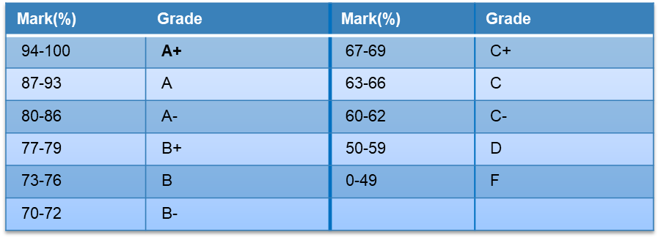
Evaluation
1. Assignments (60%)
Three practical assignments, each contributing equally.
Designed to reinforce concepts from lectures and labs.
2. Term Project (40%)
Project Proposal (10%) – Outline your idea and approach.
Progress Reports (10%) – Show your ongoing development and learnings.
Final Report (10%) – Complete documentation of your project.
Project Presentation (10%) – Demonstrate your solution and explain your approach.
3. Participation / Lab Work
Engaging in lab exercises, discussions, and hands-on workshops is strongly encouraged.
While not always graded separately, active participation will support learning and project success.

Slide 9
Encouraged: Using AI tools to learn, debug, brainstorm, and explain concepts.
Disclose: State which AI tools you used and how in each assignment.
Understand: You must be able to explain every line you submit. Expect to be asked.
Verify: AI can be confidently wrong. Test and fact-check its output.
Protect: Never paste private, personal, or confidential data into AI tools.
Integrity: Submitting AI-generated work as entirely your own violates Lambton College academic integrity policy.
Responsible AI Use in This Course

Slide 10
Our Purpose in this Course
Welcome to AML 3303, a journey into the dynamic and evolving world of AI and Machine Learning.
In this course, you will understand how AI and ML systems are built and maintained in the real world. You will learn the foundational software engineering practices, work with collaborative and version control tools, and get hands-on experience with AI/ML toolkits and services.
By connecting theory with practical workflows, the course will prepare you to work effectively on AI/ML projects and gain skills relevant to internships and industry opportunities.

Slide 11
Topics To Cover Today
Basics of Software Engineering
Principles and scope of software engineering
Software development lifecycle (SDLC) and ML lifecycle analogy
Agile vs traditional process models
Software Design Considerations
Heterogeneity, scalability, and maintainability
Security and trust in AI/ML systems
Business and social impacts on software development
Industry-Relevant Tools (Overview)
Git & GitHub – Track code and collaborate.
IDE & Hands-On Coding – Practice Python and ML workflows.
AI/ML & LLM Basics – Explore libraries and LLM concepts.
AI-Assisted & Agentic Development
AI across the software lifecycle
AI coding assistants: Claude Code, GitHub Copilot, Cursor
What is Agentic AI? The agent loop, tools, and MCP
Responsible AI use in this course
Hands-On Lab
Set up Python, VS Code, Git/GitHub, and an AI coding assistant
Q&A / Discussion
Open floor for questions, clarifications, and expectations

Slide 12
Definition of software engineering
Software engineering is an engineering discipline concerned with all aspects of software production, from the early stages of system specification through to maintaining the system after it has been deployed.
— Ian Sommerville, Software Engineering (10th ed.), Pearson, 2016

Slide 13
Modularity: Break software into smaller, manageable components.
Reusability: Design components that can be reused across projects.
Maintainability: Make software easy to update, fix, and extend.
Scalability: Ensure the system can handle growth in users, data, or complexity.
Reliability & Quality: Build software that works correctly and consistently.
Security & Trust: Protect data and maintain user confidence.
Collaboration: Promote teamwork through shared tools and processes.
Principles of Software Engineering

Slide 14
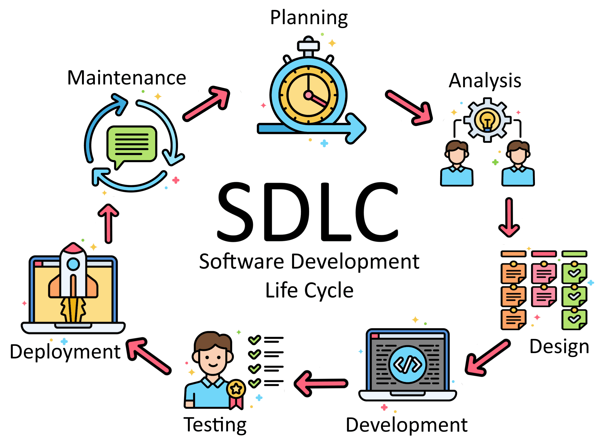
Scope of Software Engineering
Software engineering is not just about writing code—it covers the entire lifecycle of a system:
Requirements Analysis: Understand what the system should do.
Design: Plan the system architecture and components.
Implementation: Write and integrate the code.
Testing: Verify correctness, performance, and security.
Deployment: Release the system for use.
Maintenance & Evolution: Update, fix, and improve over time.

Slide 15
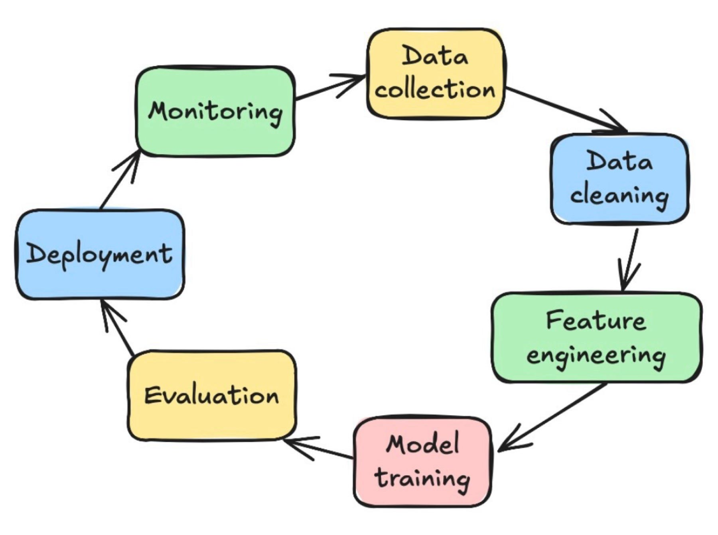
Machine Learning (ML) Lifecycle
Problem Definition – Understand the problem and set objectives.
Data Collection & Preparation – Gather and clean data for modelling.
Feature Engineering – Create and select features to improve performance.
Model Development – Train models using suitable algorithms.
Evaluation – Test and measure model performance.
Deployment – Integrate the model into applications or services.
Monitoring & Maintenance – Track and update models as needed.

Slide 16
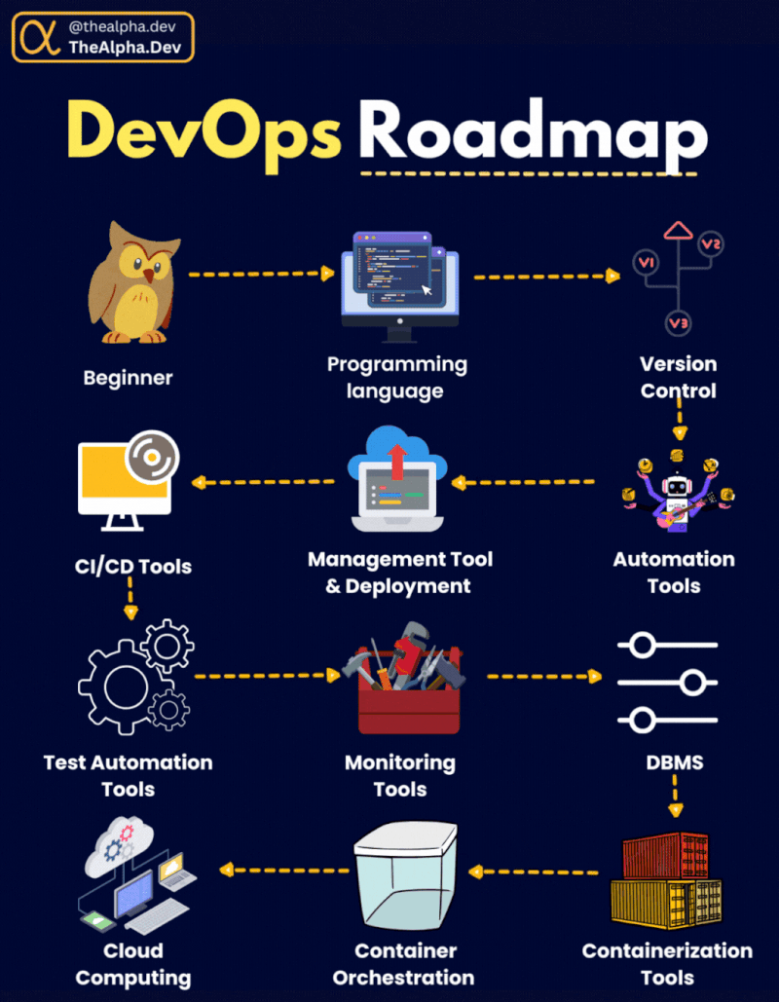
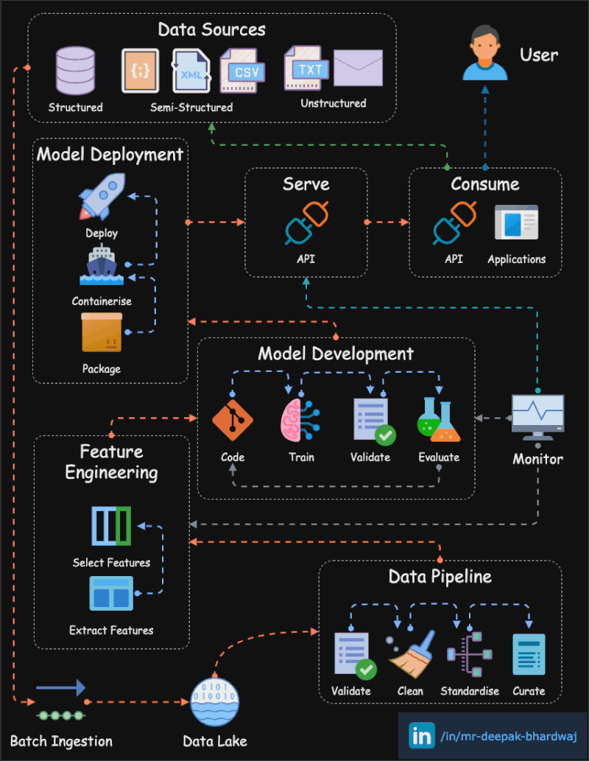

Slide 17
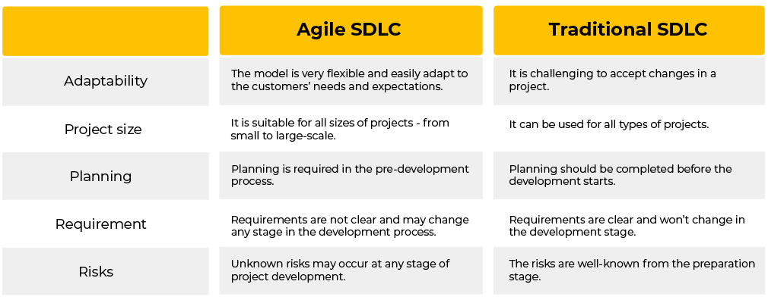

Slide 18
Software Design Considerations
1. Heterogeneity, Scalability & Maintainability
Systems must handle different platforms, data types, and user needs.
Design for growth in data, users, and features.
Ensure easy updates and long-term maintenance.
2. Security & Trust in AI/ML
Protect data privacy and system integrity.
Build reliable and explainable AI systems that users can trust.
3. Business & Social Impacts
Align software with business goals and user needs.
Consider ethical, social, and legal implications of AI/ML solutions.
💡 Key Takeaway: Good software design ensures that AI/ML systems are robust, scalable, secure, and socially responsible.

Slide 19
Requirements: Use LLMs to draft user stories, clarify requirements, and spot gaps.
Design: Brainstorm architectures and compare trade-offs with an AI assistant.
Implementation: AI coding assistants generate, refactor, and explain code.
Testing: Generate unit tests and edge cases; AI-assisted code review.
Deployment: Draft CI/CD pipelines, Dockerfiles, and infrastructure scripts.
Maintenance: Summarize bugs, trace root causes, and update documentation.
Golden rule: AI speeds you up, but you own the code. Always read, test, and understand what AI produces.
AI Across the Software Lifecycle

Slide 20



AI Coding Assistants
What are AI Coding Assistants?
AI pair programmers: tools powered by LLMs that write, explain, refactor, and debug code from natural-language instructions.
From autocomplete to agents: they now plan multi-step tasks, edit many files, run tests, and fix errors.
Popular Tools
Claude Code (Anthropic): an agentic coding tool for the terminal, IDE, desktop, and web that works across your whole codebase.
GitHub Copilot (GitHub/Microsoft): code completion, chat, and agent mode inside VS Code and JetBrains; free for verified students.
Cursor: an AI-first code editor (built on VS Code) with codebase-aware chat and agent features.
Using Them Well
Be specific: give clear context, requirements, and examples.
Stay in control: review every change, run the tests, and never share secrets or confidential code.

Slide 21
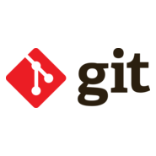

Versioning with Git
What is Git?
Git is a distributed version control system used to track code changes.
It allows multiple developers to collaborate efficiently without overwriting each other’s work.
Why Git is Important in Industry:
Collaboration: Teams can work simultaneously on the same project using branches.
Traceability: Every change is recorded, making it easy to audit and debug.
Reversibility: Mistakes can be undone by reverting to previous versions.
Continuous Integration & Deployment: Integrates seamlessly with CI/CD pipelines for automated testing and deployment.
Standard in Industry: Almost all tech companies use Git or a similar version control for software development and ML projects.

Slide 22
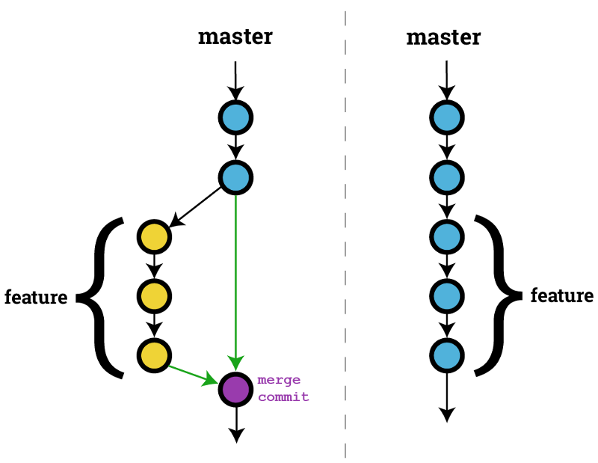
GitHub: Collaborating on Code
Git vs. GitHub
Git is the version control tool on your computer; GitHub is a cloud platform that hosts Git repositories.
GitHub Issues
Track tasks, bugs, and enhancements; assign work to teammates.
Pull Requests (PRs)
Propose changes from a branch, get code reviews, then merge.
GitHub Actions
Automate CI/CD: run tests, build, and deploy on every push.
GitHub Projects & Copilot
Plan work on boards; use AI to write code, review PRs, and fix issues.

Slide 23
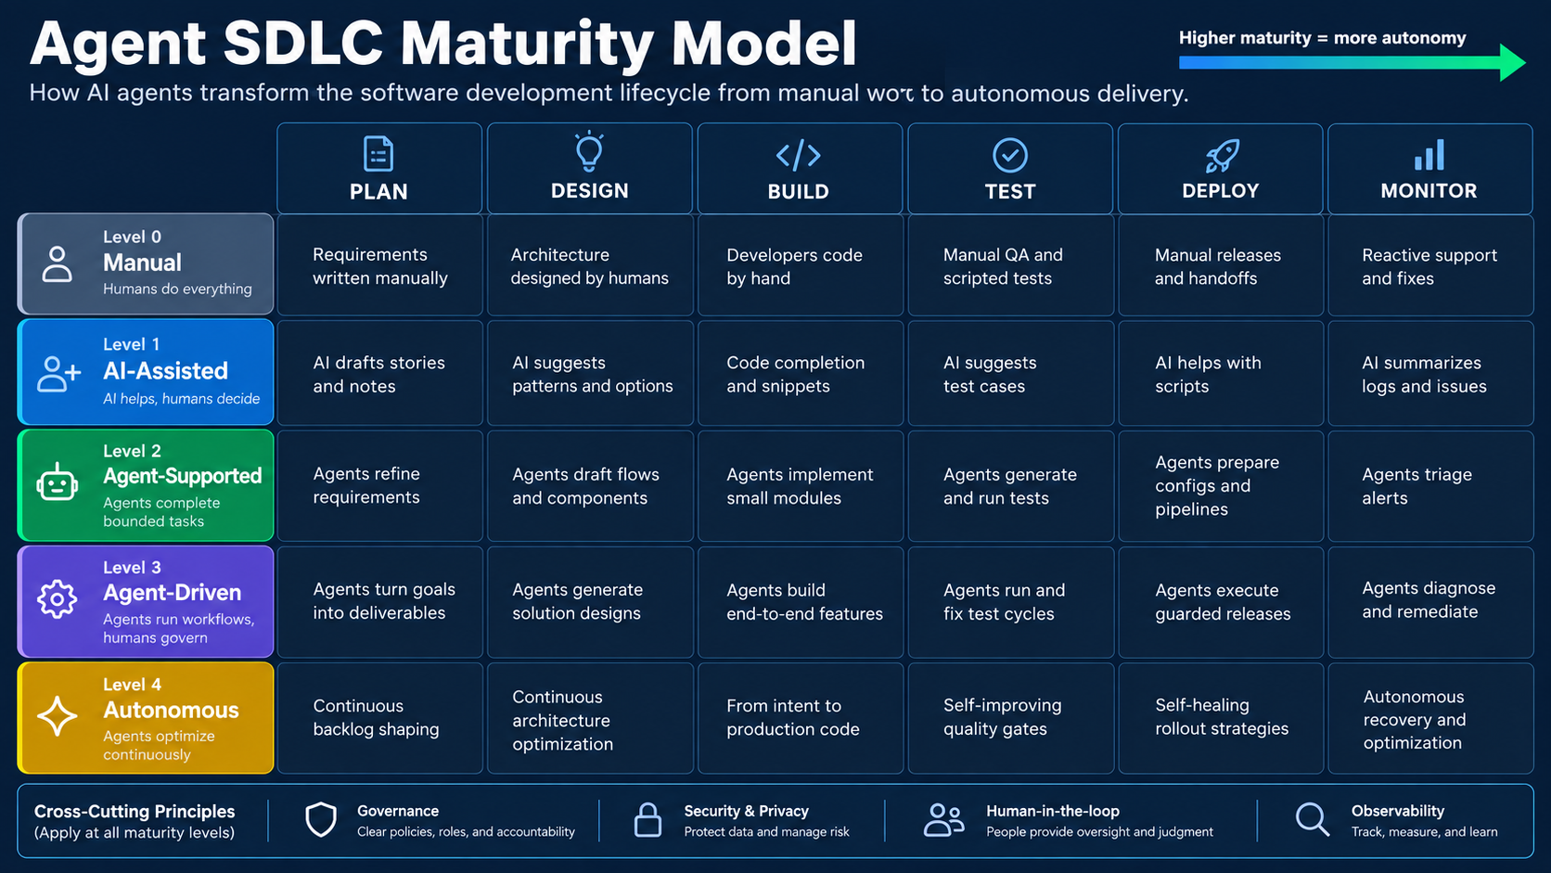

Slide 24
git config --global user.name / user.email → Set your identity (once per machine)
git init / git clone <url> → Create a new repo or copy an existing one
git status → See what has changed
git add <file> / git commit -m "message" → Stage and save a snapshot
git push / git pull → Sync with the remote repository (GitHub)
git switch -c <branch> → Create and move to a new branch (newer alternative to git checkout -b)
git merge <branch> → Combine branches
git log --oneline → View commit history
Best practices: Commit small and often, write clear messages, use a .gitignore, and NEVER commit API keys or passwords (use .env files).
Essential Git Commands

Slide 25
Step 1: Install Python 3.12+ and VS Code (with the Python and Jupyter extensions).
Step 2: Create a virtual environment (python -m venv .venv, or uv venv).
Step 3: Install Git, configure your name and email, and create a GitHub account.
Step 4: Create a repo, add a README.md and .gitignore, and make your first commit and push.
Step 5: Enable an AI coding assistant (e.g., GitHub Copilot, free with the GitHub Student Developer Pack).
Step 6: Ask the assistant to write a small Python script, then review, run, and commit it.
Deliverable: Submit your GitHub repository link.
Hands-On Lab: Set Up Your AI Dev Environment

Slide 26
Software engineering principles apply directly to AI/ML systems.
Git & GitHub are non-negotiable industry skills. Practice daily.
AI-assisted and agentic development are changing how software is built; learn to use them responsibly.
Before next week: Finish the lab setup and push your first repository.
Next week: Data Tools for AI: Pandas, NumPy, SQL, and visualization.
Questions? Open floor for questions, clarifications, and expectations.
Key Takeaways & Next Week

